Slide 1

CEIS110: Introduction to Python Programming
By Kassandra Moreno

Slide 2

introduction
In today’s day and age, data is becoming more and more relevant to understand and analyze for personal and business purposes. This semester, I have been allowed to build my understanding of data gathering and processing for the first time! By the end of this project, I had created a visual representation through graphing to diagnose a trend and predict a weather pattern.

Slide 3
Agenda
Software Installation
Project Planning And Library Setup
Downloading Weather Data
Querying Database With SQL
Querying And Manipulating Database With SQL And Python
Developing Graphical Models And Interpret Results
Course Challenges
Career Skills Obtained
Conclusion

Slide 4
Software Installation
To begin my weather data project, I needed Excel and Anaconda.
Excel
DeVry University gives all its students Microsoft 365. which contains Microsoft Excel.
Anaconda
Visit: https://www.anaconda.com/download/
Choose the download for your operating system and ensure it’s the latest version and a 64-bit graphical installer.

Slide 5
Project planning and Library setup

Slide 6

Project Flow chart
Start
Install Python Modules
Download Weather Data to Database
Extract Weather Data into CS,V File
Cleanse Weather Data
Use Excel to Manipulate data
Use Python Data Analytics Modules to Develop Graphical Models
End

Slide 7
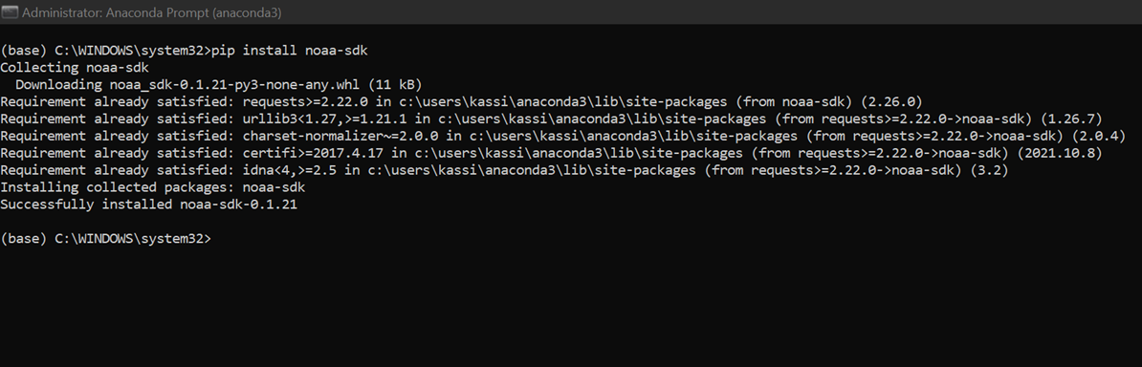
SOFTWARE INVENTORY
Steps for success:
Right-click Anaconda Prompt (anaconda3) and select “Run as Administrator” to open the Anaconda Prompt command window.
Enter “pip install noaa-sdk” into the prompt. Wait for the output “Successfully installed noaa-sdk”.

Slide 8
Downloading weather data

Slide 9
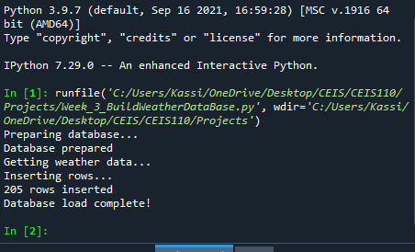
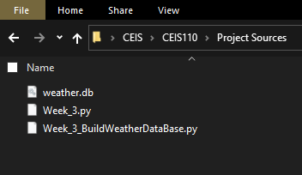
Code
Execution
Database files

Slide 10
Querying database with SQL

Slide 11
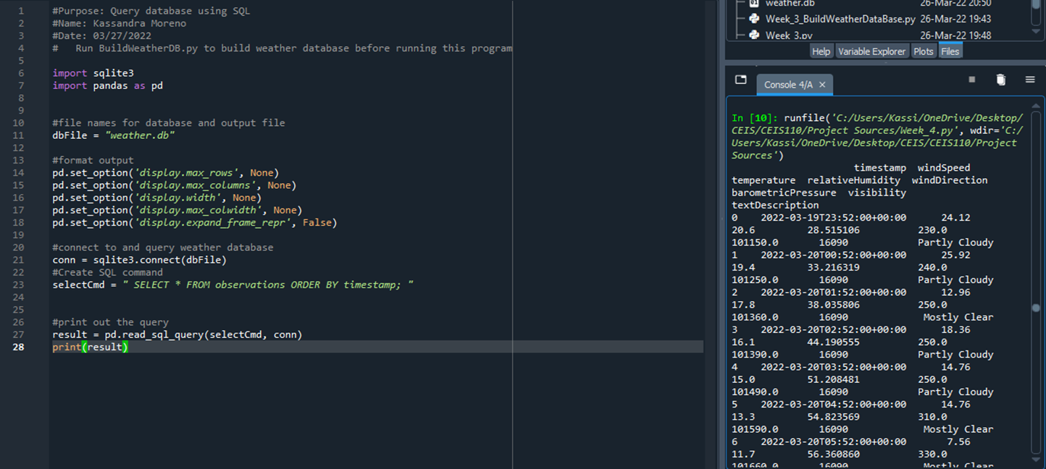
Query to retrieve all columns and all rows

Slide 12
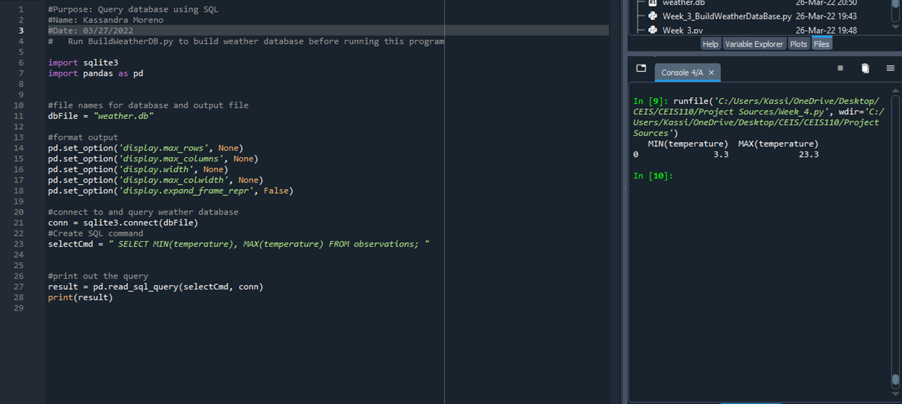
Query to retrieve lowest and highest temperatures

Slide 13
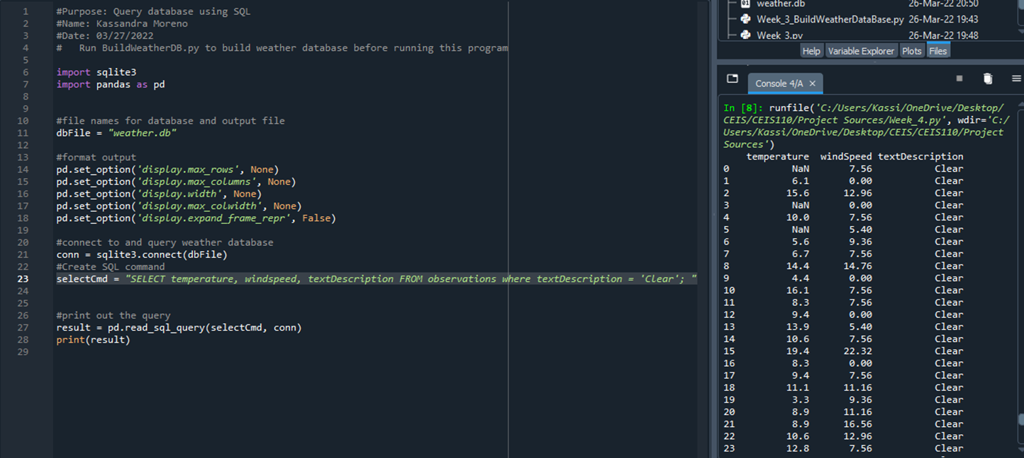
Query to retrieve all clear days

Slide 14
Querying and manipulating Data with sql and python

Slide 15
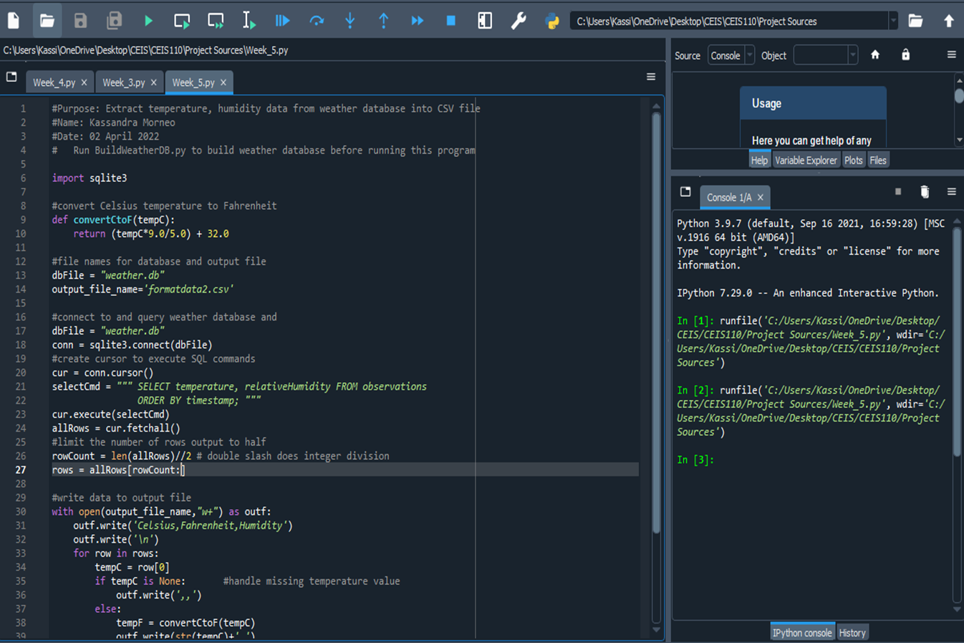
Python Code

Slide 16
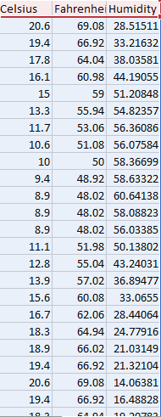
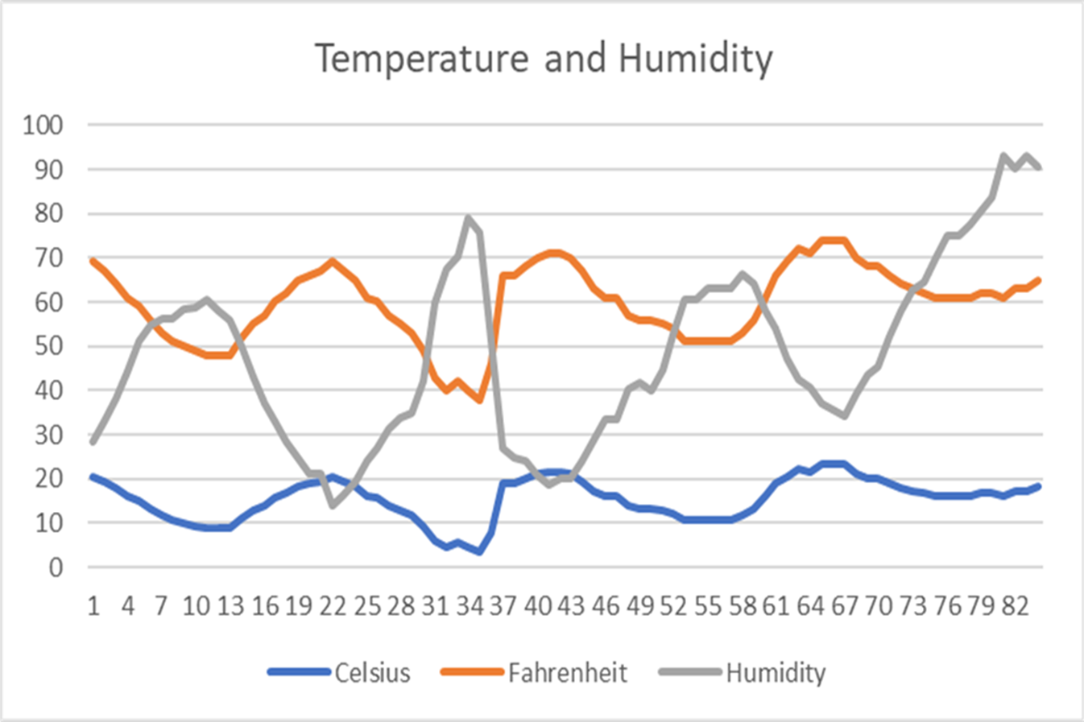
Data retrieved and converted to CSV Format with it’s respective Temperature and Humidity Chart

Slide 17
Developing graphical models and interpret results

Slide 18
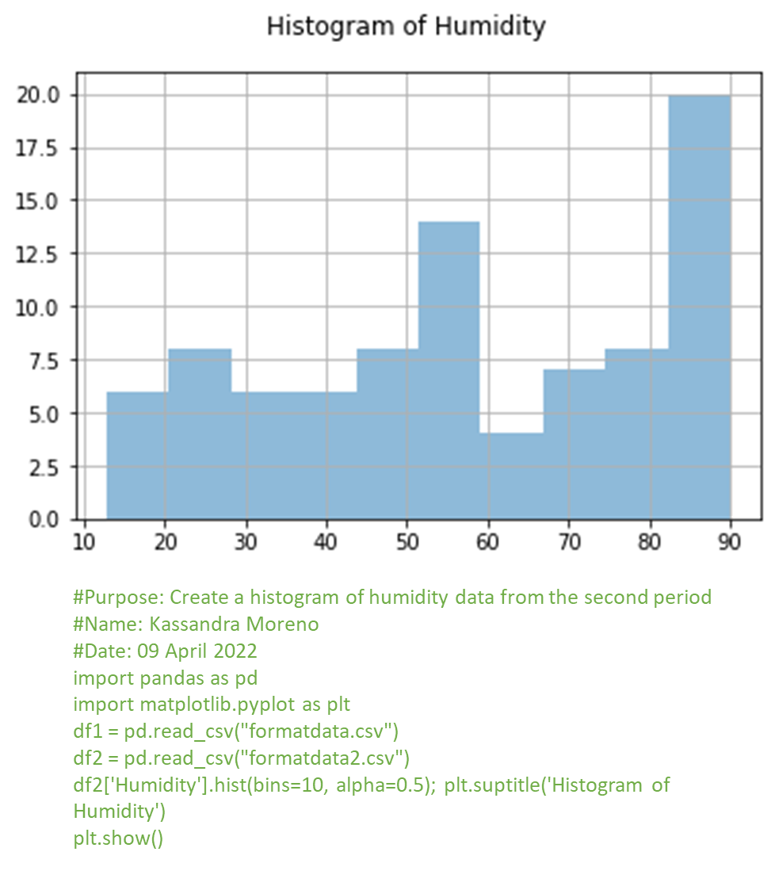
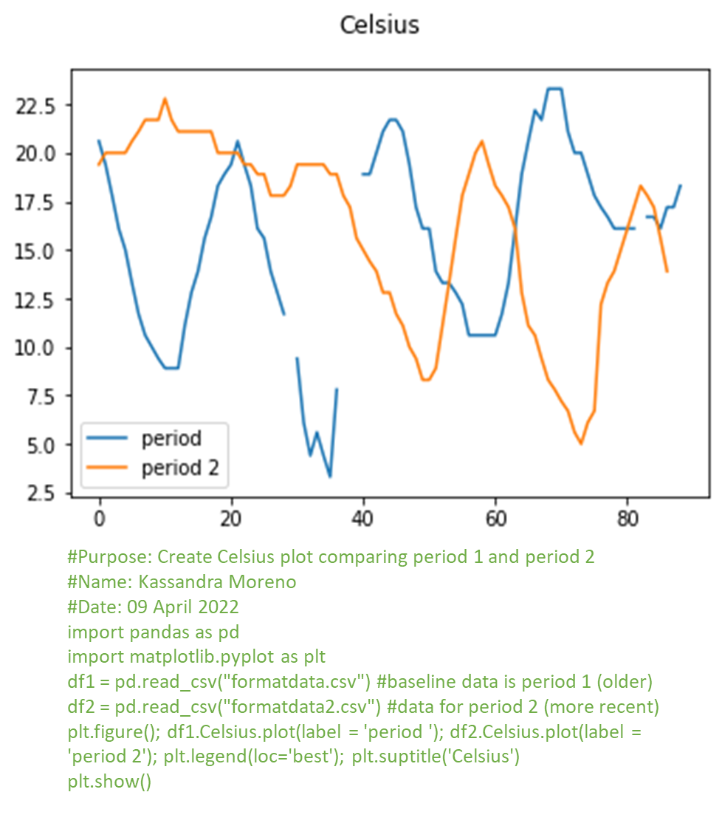
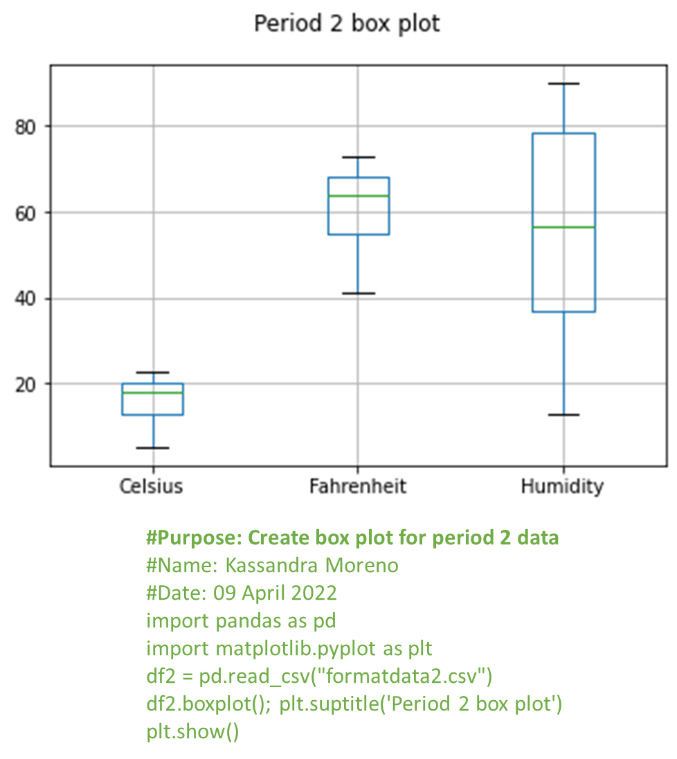
Data Plots

Slide 19
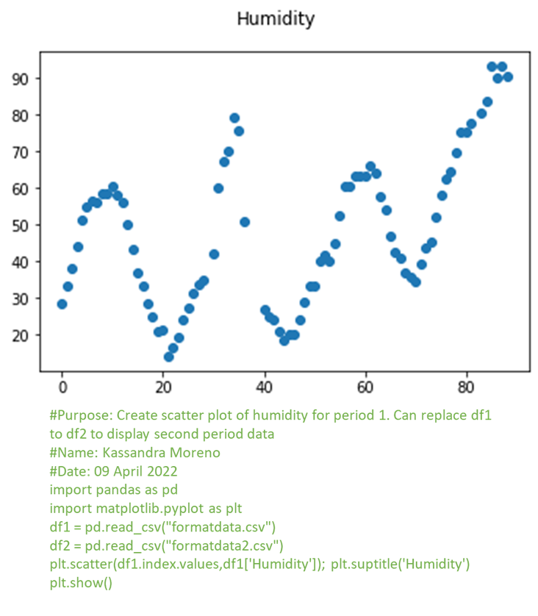
Analysis: Did the humidity rise as springtime approached?
Answer: Yes.
Evidence is supported by scatterplot.

Slide 20
Course challenges
Throughout this new experience, I have had my fair share of challenges, and I would say that my biggest challenge would have been understanding where and how to manipulate data coding. While this is not my first time working with Python coding, this was a completely different approach from my previous Arduino Home Security Project! I truly enjoyed seeing what else Python programming is capable of, and I can’t wait to see what more is in store as I continue my path toward Cybersecurity Programming.

Slide 21
career skills obtained
Everything I did in this project has taught me something valuable that could be taken into the work field. My favorite career obtained skill would be creating a graph based on collected data, and I never thought you could make a diagram without converting it to an Excel sheet. While I enjoy Excel, I appreciate learning that I don’t have to switch to Excel to make my downloaded data a graph.

Slide 22
conclusion
Thank you for taking the time to view my first data processing experience. In the previous slides, I have walked you through every step I took to graph two weeks' worth of NOAA weather data in order to generate a conclusion drawn from the analysis. The experience was enjoyable and filled with so much new knowledge, and I am happy to have been given this opportunity.

